Slide 1

E-Commerce Sales Analysis
DATA ANALYSTS & DATA SCIENTISTS
Name : Manjunath M Bandiwaddar

Slide 2
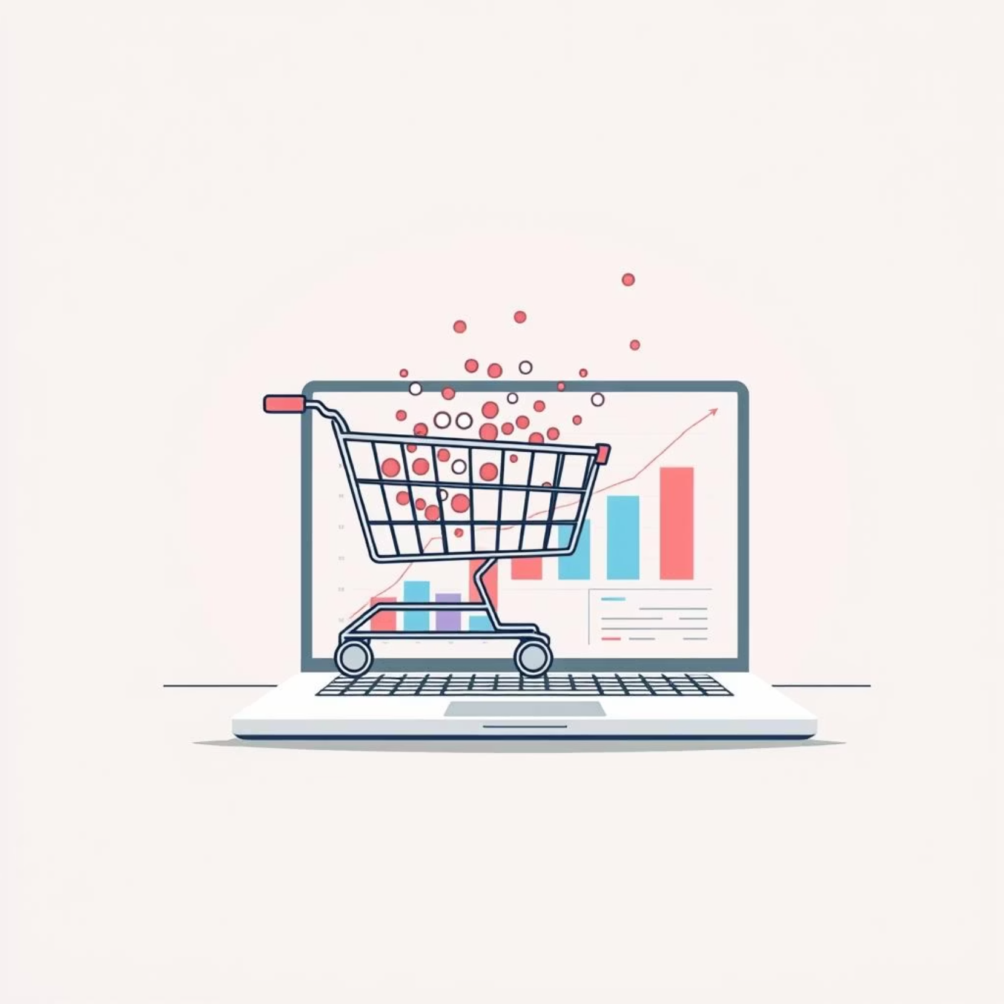
E- Commerce Sales Analysis
E-commerce is one of the fastest-growing industries.
Analyzing sales data helps identify trends, customer
preferences, and business opportunities.
This project focuses on exploring sales patterns and
extracting meaningful insights to support decision-making.

Slide 3
Key Objectives: Unlocking Sales Performance
Monthly Sales Performance
Identify peak and lowest sales months to understand seasonality and demand fluctuations.
Product Category Analysis
Determine top-performing and underperforming product categories for strategic inventory management.
Sub-Category Deep Dive
Further refine product insights by analyzing sales at the sub-category level.

Slide 4
Methodology: A Data-Driven Approach
01
02
03
Data Extraction & Cleaning
Ensuring data quality and integrity is the first step for accurate analysis.
Exploratory Data Analysis (EDA)
Visualizing data to uncover initial patterns, anomalies, and relationships.
Feature Engineering
Creating new variables from existing ones to enhance model performance.
04
05
Statistical Modeling
Applying appropriate statistical techniques to validate hypotheses and predict future trends.
Reporting & Visualization
Communicating findings clearly and effectively through interactive dashboards and reports.

Slide 5

Customer Segmentation: Tailoring Strategies
1
Sales by Customer Segment
Understand purchasing behavior and preferences of different customer groups.
2
Profit by Customer Segment
Assess the profitability contributions of each customer segment.

Slide 6
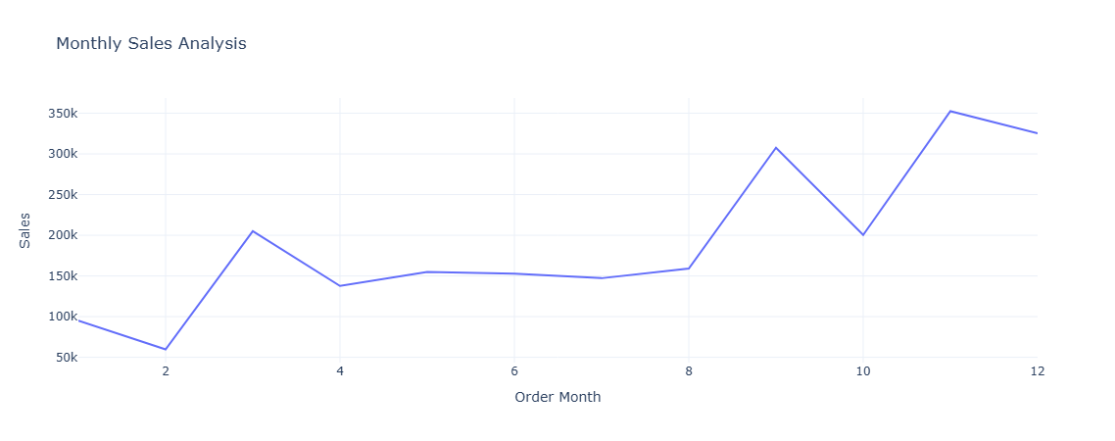
Sales by Month

Slide 7
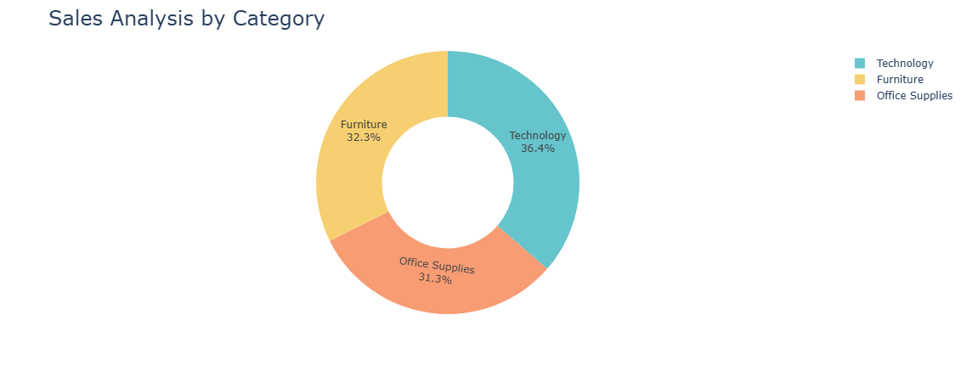
Sales Analysis by Category

Slide 8
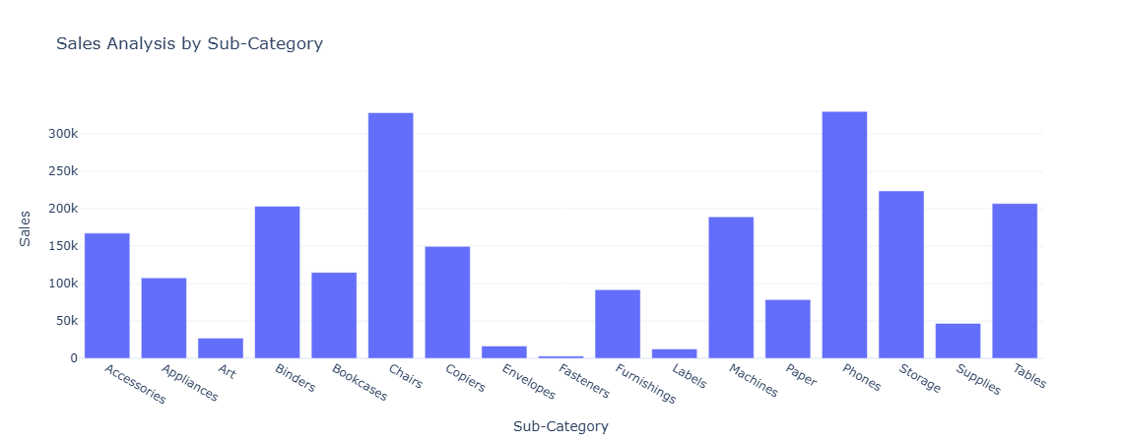
Sales Analysis by Sub-Category

Slide 9
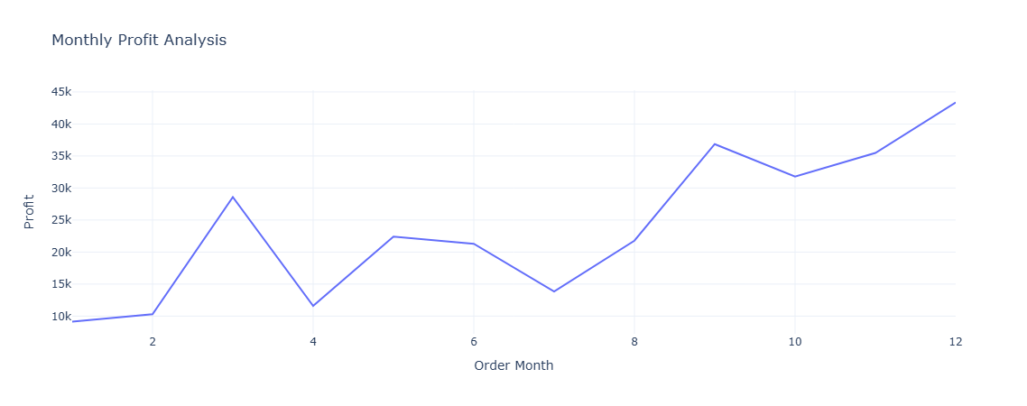
Monthly Profit Analysis

Slide 10
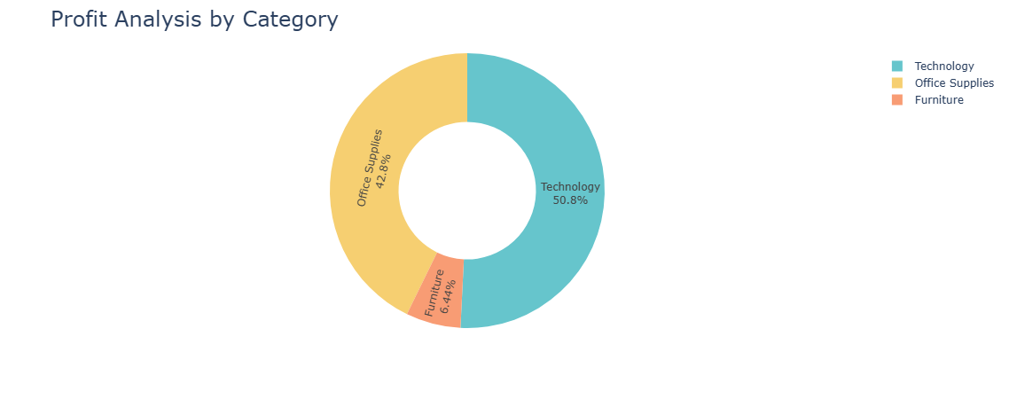
Profit Analysis by Category

Slide 11
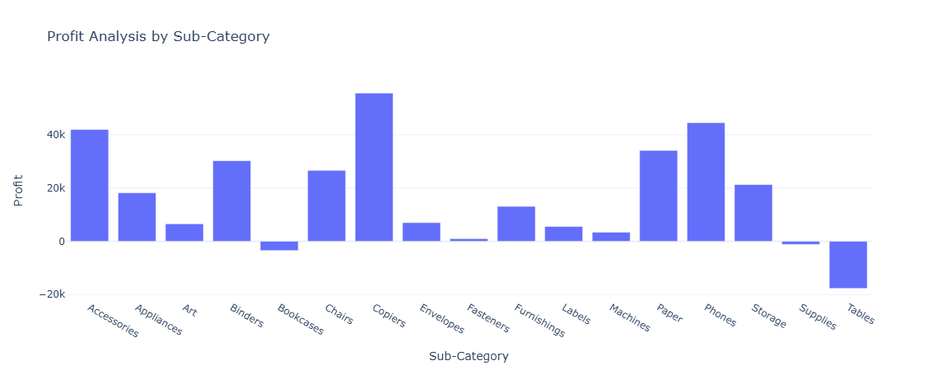
Profit Analysis by Sub-Category

Slide 12
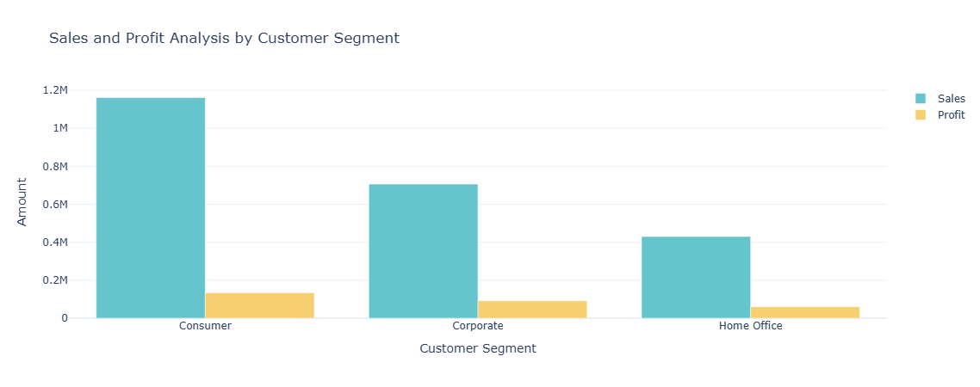
Sales and Profit Analysis by Customer Segment

Slide 13

Conclusion
Data analysis provides deeper insights into customer and sales behavior.
E-commerce companies can leverage these findings to improve decision-making.
Continuous monitoring of data will help sustain growth in a competitive market.

